Slide 1
Challenge 2 Collecting, Saving, and Visualizing Data from the Physical World
Team members:
Shisheng wang
xiangtian yi
Ye xing
Yanlin zhou

Slide 2




Presenter on this challenge
 | Xiangtian | Shisheng | Ye | Yanlin
Challenge 1 | Presenter
Challenge 2 |  | Presenter
Challenge 3 |  |  | Presenter
Challenge 4 |  |  |  | Presenter
Challenge 5 | Presenter
Challenge 6 |  | Presenter
Challenge 7 |  |  | Presenter
Challenge 8 |  |  |  | Presenter

Slide 3
TEAM WORK
Xiangtian | Shisheng | Ye | Yanlin
I implemented the historical page, reading data from MySQL database. Created the back-end server via AJAX, extracted data from the database and presented it via ZingChart. Ensured the correctness and consistency of data by selecting specific date. Besides, I defined the database table structure and the way to obtain it. | I wrote and modified the node.js file to transfer data from router to the html file and connect it to mysql database so that we could store any temperature data into database.And I also engaged in setting up Pi's environment with Ye. | I mainly take charge of the raspberry pi. Including set up the OS and WIFI, installing the Mysql, apache2 and PHP. Engaging the javascript file design. The ways to store xbee routers and identifier them. | I designed the user interface of two webpages which is the Real-time temperature page and the historical page and programmed in html and Javascript. Also, I applied the chart model from ZingChart by applying API and modified the charts to make them suits for our data.

Slide 4



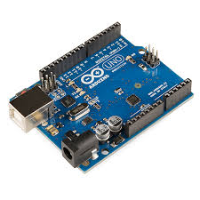
architecture
Request
Historical/Real-time data
Store data continuously
Send
Historical/Real-time data
Retrieves historical data

Slide 5

Design tools
Charting Library: ZingChart
Various charts online
Easy to apply
Support Real-time data
Data Storage: My SQL
Easy to use on Mac
Relational Database

Slide 6
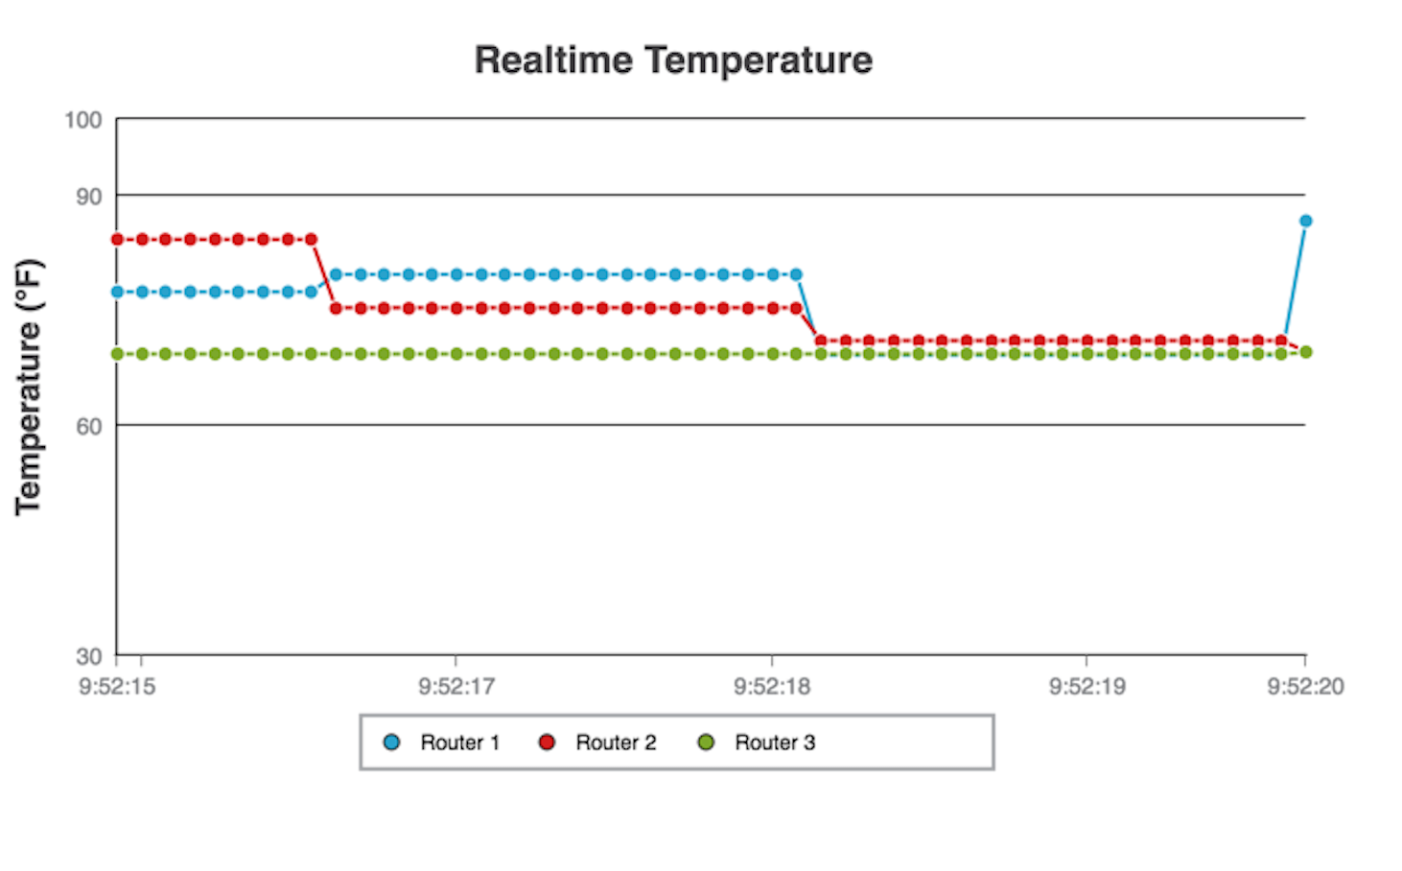
User Interface design
For the Real-time Temperature, we use a coordinate graph to show the temperature

Slide 7
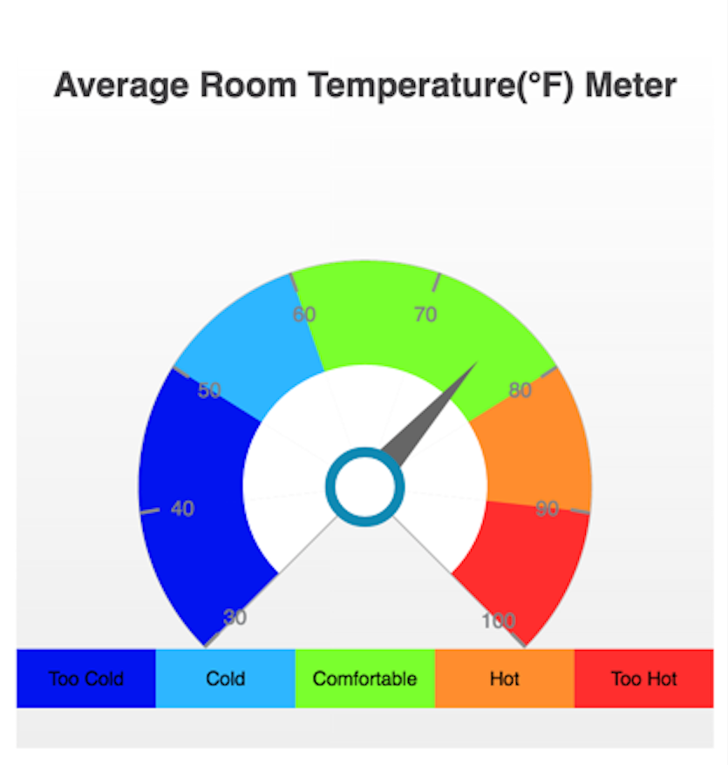
User Interface design
For the Average Temperature, we use a meter chart to show the temperature

Slide 8
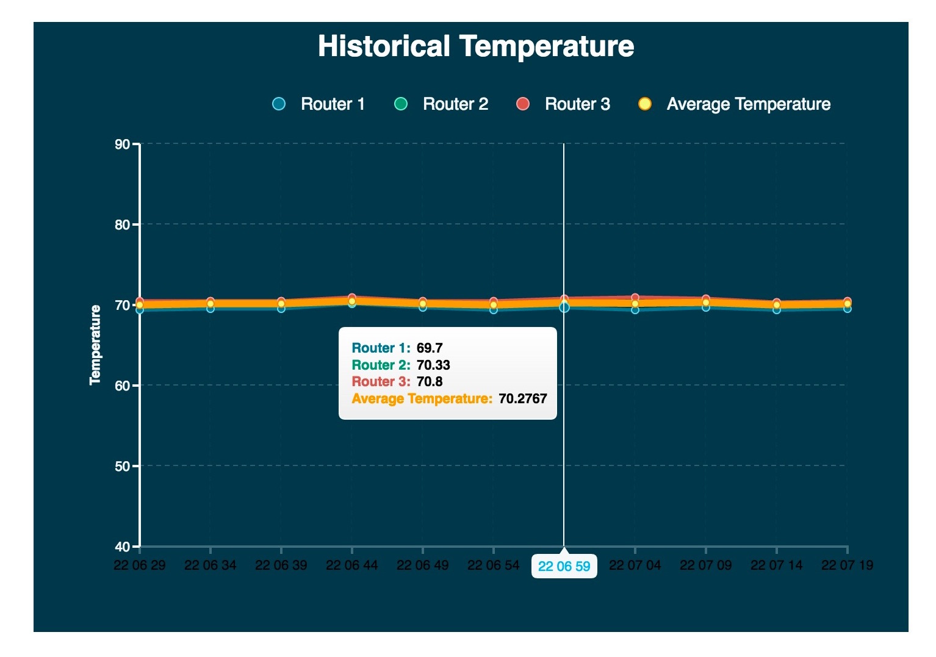
User Interface design
For the Historical temperature data, we choose to use the four lines to show the temperature data from different routers and the bolder line to show the historical average temperature data

Slide 9
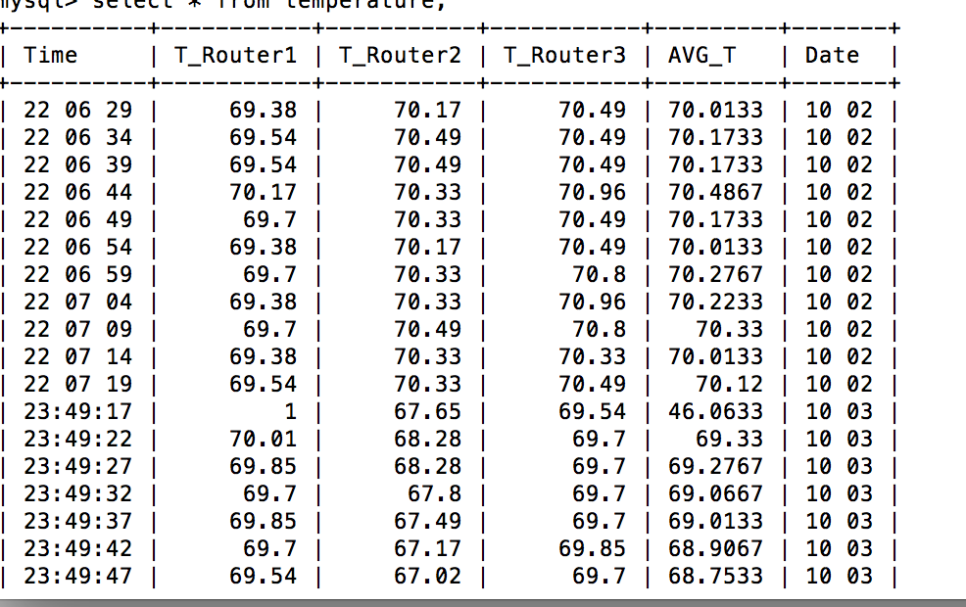
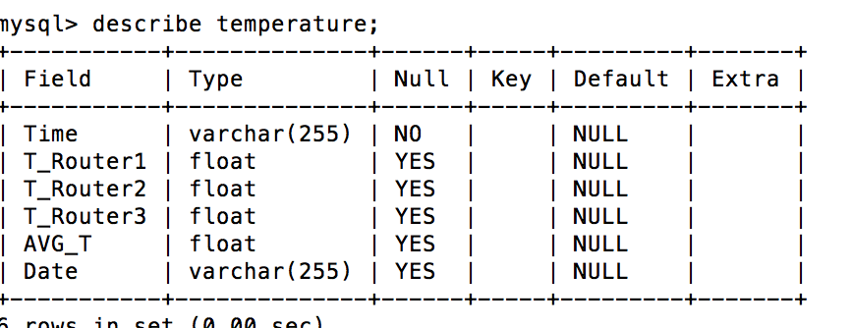
DATABASE
We use MYSQL to store our data.
The data and the table are presented below

Slide 10
Challenges
Learning to use the ZingChart API
Choosing a charting library which suits for the design architecture
Learning to integrate HTML, JavaScript, CSS, ZingChart, etc.
Learning to apply data from My SQL database on HTML
solve the circuit design issue in Challenge 1
Implement PHP Server on Raspberry Pi

Slide 11
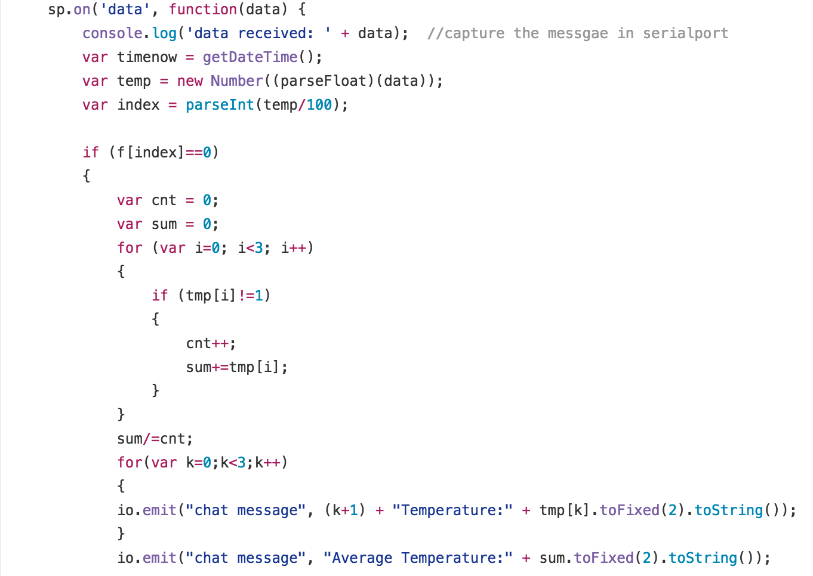
Improvement
Improved the circuit design problem in Challenge 1 to solve the sensor problem
Optimized the Arduino code to take router broken into consideration

Slide 12
Future improvement
Better layout design
Make the chart more interactive
Find a better way to implement PHP and Server on Pi

Slide 13
Thank you !

